Slide 1
Linear Regression

Slide 2
What is a linear regression
How do we make a linear regression
Assessing the model
Demo in Python

Slide 3
What is linear regression?
Regression is an approach/method/algorithm used in finding the relationship between explanatory variables (or independent variables) and our variable of interest (or dependent variable).

Slide 4
What is linear regression?
Said another way, we are interested in finding out how much our variable of interest (Y), will increase (or decrease) with a change in each of our explanatory/indep. variables (X₁, X₂, …)

Slide 5
Examples
I work at Adobe. Work with lots of online retailers. A very common question is “How much is a visit worth (in terms of revenue)?”
How is Revenue (Y) related to number of visits (X)?
Natural extension of this is how is revenue related to different types of visits (google search, direct type, email campaign, etc.)?

Slide 6
Examples
How can I estimate the value of a car?
Simple approach = value of car by the odometer
Advanced approach = for each make and model, how do the odometer reading change the value.

Slide 7
Examples
What are some factors that influence house prices and how much do they influence them?
Price (Y) related to:
Number of bedrooms (X₁)
Number of bathrooms (X₂)
Square footage (X₃)
Lot size (X₄)
Etc.

Slide 8
How do we create a linear regression?

Slide 9
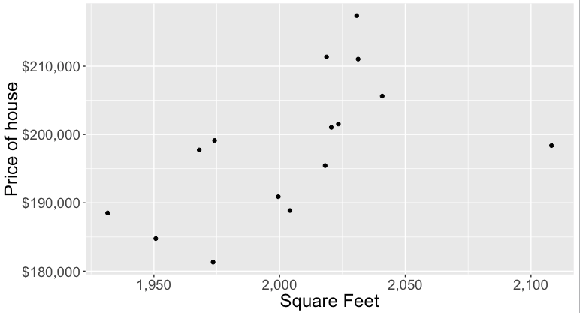
Creating a Linear Regression

Slide 10
Drawing a line
Slope intercept
β₀ = y-intercept
β₁ = slope of the line
y
Rise
β₁ = Rise/Run
β₀
Run
x

Slide 11
Introduction
We will examine the relationship between quantitative variables x and y via a mathematical equation.
The motivation for using the technique:
Forecast the value of a dependent variable (y) from the value of independent variables (x₁, x₂,…x_{k}.).
Analyze the specific relationships between the independent variables and the dependent variable.

Slide 12
The Model
The model has a deterministic and a probabilistic components
House
Cost
Building a house costs about
$75 per square foot.
House cost = 25000 + 75(Size)
Most lots sell
for $25,000
House size

Slide 13
The Model
However, house cost vary even among same size houses.
Since cost behave unpredictably, we add a random component.
House
Cost
Most lots sell
for $25,000
House cost = 25000 + 75(Size)
+ ε
House size

Slide 14
The Model
The first order linear model
y = dependent variable
x = independent variable
β₀ = y-intercept
β₁ = slope of the line
ε = error variable
β₀ and β₁ are unknown population parameters, therefore are estimated
from the data.
y
Rise
β₁ = Rise/Run
β₀
Run
x

Slide 15
Estimating the Coefficients
The estimates are determined by
drawing a sample from the population of interest,
calculating sample statistics.
producing a straight line that cuts into the data.
y
w
Question: What should be considered a good line?
w
w
w
w
w w w w
w
w w
w w
w
x

Slide 16
The Least Squares (Regression) Line
A good line is one that minimizes the sum of squared differences between the
points and the line.

Slide 17
The Least Squares (Regression) Line
Sum of squared differences =
(2 - 1)² +
(4 - 2)² +
(1.5 - 3)² +
(3.2 - 4)² = 6.89
Sum of squared differences =
(2 -2.5)² +
(4 - 2.5)² +
(1.5 - 2.5)² +
(3.2 - 2.5)² = 3.99
Let us compare two lines
4
(2,4)
w
The second line is horizontal
3
w
(4,3.2)
2.5
2
w
(1,2)
(3,1.5)
w
The smaller the sum of
squared differences
the better the fit of the
line to the data.
1
1
2
3
4

Slide 18
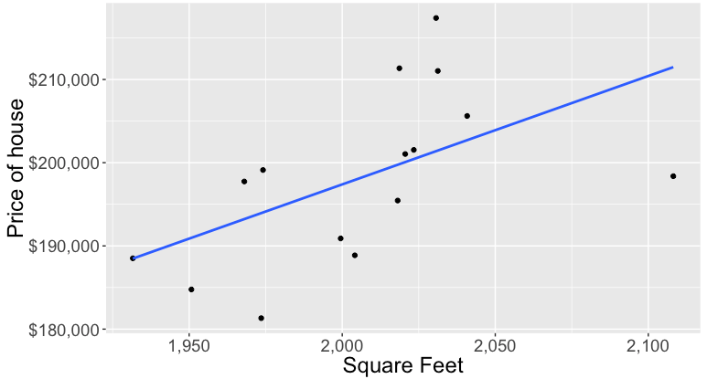
Creating a Linear Regression

Slide 19
The Estimated Coefficients
To calculate the estimates of the slope and intercept of the least squares line , use the formulas:
To extended to multiple independent variables and betas, use matrix multiplication:

Slide 20
Example:
The Simple Linear Regression Line
A car dealer wants to find the relationship between the odometer reading and the selling price of used cars.
A random sample of 100 cars is selected, and the data recorded.
Find the regression line.
Independent variable x
Dependent variable y

Slide 21
The Simple Linear Regression Line
Solution
Solving by hand: Calculate a number of statistics
where n = 100.

Slide 22
Using the Regression Equation
Before using the regression model, we need to assess how well it fits the data.
If we are satisfied with how well the model fits the data, we can use it to predict the values of y.
To make a prediction we use
Point prediction, and
Interval prediction

Slide 23
Assessing the model

Slide 24
Assessing the Model
The least squares method will produces a regression line whether or not there is a linear relationship between x and y.
Consequently, it is important to assess how well the linear model fits the data.
Several methods are used to assess the model.

Slide 25
Testing the slope
When no linear relationship exists between two variables, the regression line should be horizontal.
q
q
q
q
q
q
q
q
q
q
q
q
q
q
q
q
q
q
q
q
q
q
q
q
Linear relationship.
Linear relationship.
Linear relationship.
Linear relationship.
No linear relationship.
Different inputs (x) yield
the same output (y).
Different inputs (x) yield
different outputs (y).
The slope is not equal to zero
The slope is equal (or close) to zero

Slide 26
Coefficient of determination
To measure the strength of the linear relationship we use the coefficient of determination.
R² takes on any value between zero and one.
R² = 1: Perfect match between the line and the data points.
R² = 0: There are no linear relationship between x and y.

Slide 27
Regression Diagnostics
The three conditions required for the validity of the regression analysis are:
the error variable is normally distributed.
the error variance is constant for all values of x.
The errors are independent of each other.
How can we diagnose violations of these conditions?

Slide 28
Residual Analysis
Examining the residuals help detect violations of the required conditions.
Checking to see if residuals (actual value – predicted value) are normally distributed with mean 0.

Slide 29
Residual Analysis
It seems the residual are normally distributed with mean zero

Slide 30
Heteroscedasticity
When the requirement of a constant variance is violated we have a condition of heteroscedasticity.
Diagnose heteroscedasticity by plotting the residual against the predicted y.
+
^
y
+
+
Residual
+
+
+
+
+
+
+
+
+
+
+
+
+
+
+
+
+
+
+
+
+
+
+
+
^
+
+
+
+
+
y
+
+
+
+
+
+
+
+
+
+
+
+
+
+
+
^
The spread increases with y

Slide 31
Non Independence of Error Variables
A time series is constituted if data were collected over time.
Examining the residuals over time, no pattern should be observed if the errors are independent.
When a pattern is detected, the errors are said to be autocorrelated.
Autocorrelation can be detected by graphing the residuals against time.

Slide 32
Non Independence of Error Variables
Patterns in the appearance of the residuals over time indicates that autocorrelation exists.
Residual
Residual
+
+
+
+
+
+
+
+
+
+
+
+
+
0
+
0
+
Time
Time
+
+
+
+
+
+
+
+
+
+
+
+
+
Note the runs of positive residuals,
replaced by runs of negative residuals
Note the oscillating behavior of the
residuals around zero.

Slide 33
Point Prediction
Example
Predict the selling price of a three-year-old Taurus with 40,000 miles on the odometer.
A point prediction
It is predicted that a 40,000 miles car would sell for $14,575.
How close is this prediction to the real price?

Slide 34
Procedure for Regression Diagnostics
Develop a model that has a theoretical basis.
Determine the regression equation.
Check the required conditions for the errors.
Assess the model fit.
If the model fits the data, use the regression equation.
NOTE: ALWAYS REMEMBER CORRELATION VS CAUSATION. As data miners, you almost never prove causation. Only correlation. http://www.tylervigen.com/spurious-correlations

